Slide 1



Finding the Median Using Quickselect: A Decrease-and-Conquer Strategy
22ITT31 - Design & Analysis of Algorithm
Presented By :
Mounith D
23ITR103
B.Tech IT - B

Slide 2
Problem Statement
In many real-world applications, efficiently finding the median of a dataset is critical—for example, in statistics, data analysis, and real-time systems. Traditional sorting-based methods require O(n log n) time, which is inefficient for large datasets.
This project aims to:
Implement the Quickselect algorithm based on the Decrease-and-Conquer strategy to find the median in an unsorted list of n numbers.
Provide both recursive and non-recursive implementations.
Compare their efficiencies in terms of time and space complexity.
The goal is to demonstrate how Quickselect can find the median in linear time on average, making it a powerful alternative to full sorting when only the median is needed.

Slide 3
Objectives
To implement the Quickselect algorithm using both recursive and non-recursive approaches to find the median of a list.
To apply the Decrease-and-Conquer strategy for solving the median-finding problem efficiently.
To analyze and compare the performance of both implementations in terms of time and space complexity.

Slide 4
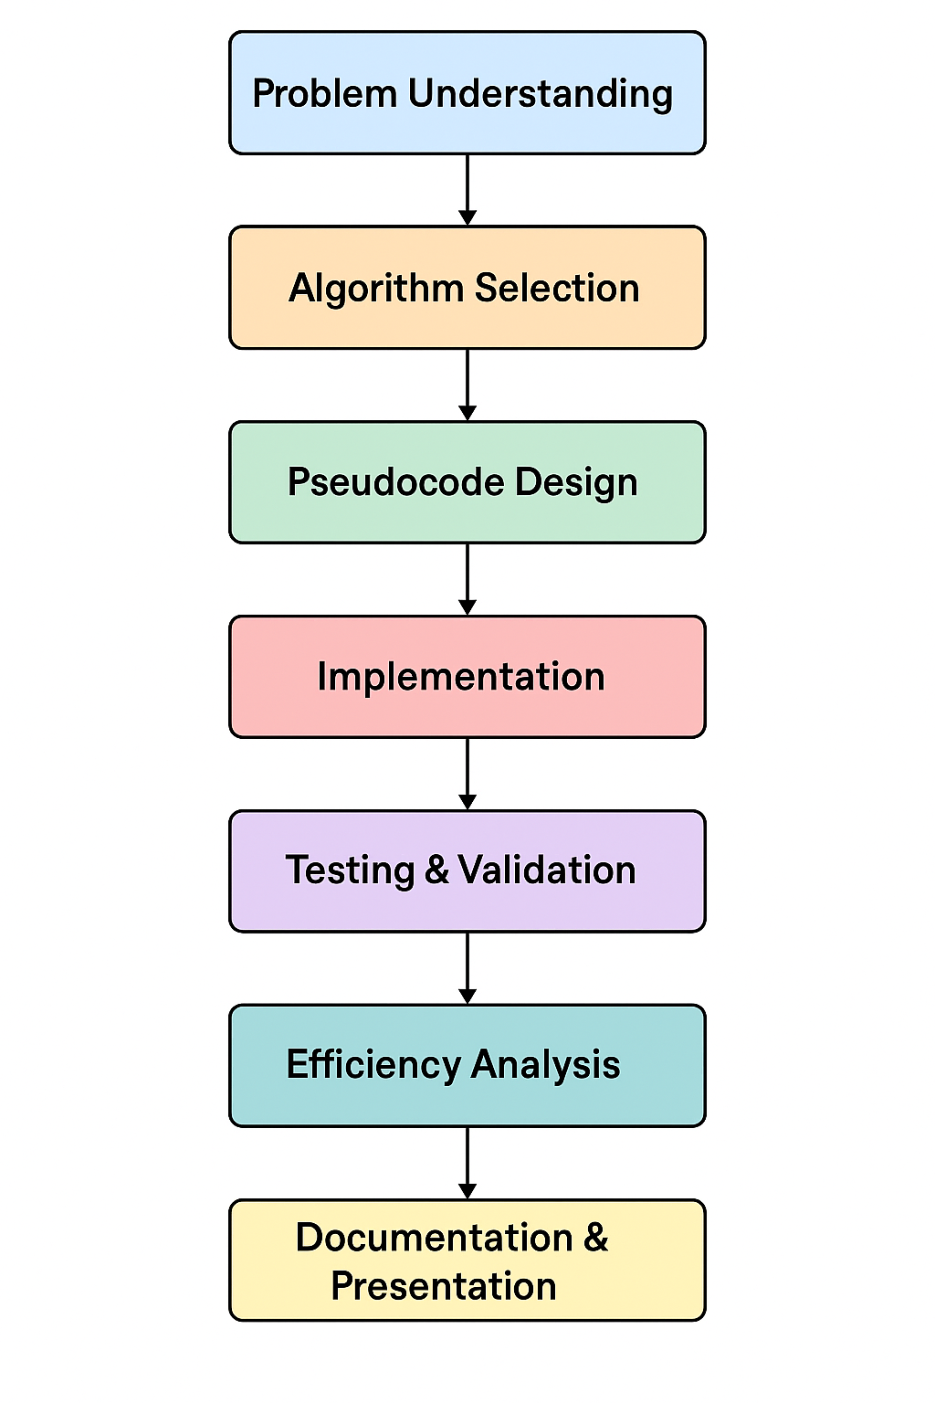
Workflow

Slide 5
Algorithm
Determine the position of the median (k):
If n is odd, set k = n // 2 (e.g., for 5 elements, the median is at position 2).
If n is even, choose either of the two middle positions based on the requirement.
Choose a pivot element:
Select a pivot from the list, typically the last element for simplicity.
Partition the list:
Rearrange the list such that all elements less than or equal to the pivot are moved to the left, and all elements greater than the pivot go to the right.
Check the pivot’s index:
After partitioning, the pivot will be in its correct sorted position.
Compare the pivot’s index with k:
If the pivot’s index equals k, return the pivot as the median.
If the pivot’s index is greater than k, repeat the process on the left subarray.
If the pivot’s index is less than k, repeat the process on the right subarray.
Repeat until the median is found:
Narrow the search space by repeating the partitioning and checking steps until the median is located.

Slide 6
Pseudocode
1. Recursive Quickselect Pseudocode
Input: Adjacency matrix of size n x n
Output: Median of the list
1. function quickselect(arr, left, right, k):
2. if left == right:
3. return arr[left]
4. pivot_index = partition(arr, left, right)
5. if k == pivot_index:
6. return arr[k]
7. else if k < pivot_index:
8. return quickselect(arr, left, pivot_index - 1, k)
9. else:
10. return quickselect(arr, pivot_index + 1, right, k)
11. function partition(arr, left, right):
12. pivot = arr[right]
13. i = left - 1
14. for j = left to right - 1:
15. if arr[j] <= pivot:
16. i += 1
17. swap(arr[i], arr[j])
18. swap(arr[i + 1], arr[right])
19. return i + 1
20. function find_median(arr):
21. n = length(arr)
22. k = n // 2 if n % 2 == 1 else n // 2 - 1
23. return quickselect(arr, 0, n - 1, k)
2. Non-Recursive Quickselect Pseudocode
Input: Adjacency matrix of size n x n
Output: Median of the list
1. function quickselect(arr, left, right, k):
2. while left < right:
3. pivot_index = partition(arr, left, right)
4. if k == pivot_index:
5. return arr[k]
6. else if k < pivot_index:
7. right = pivot_index - 1
8. else:
9. left = pivot_index + 1
10. return arr[left]
11. function partition(arr, left, right):
12. pivot = arr[right]
13. i = left - 1
14. for j = left to right - 1:
15. if arr[j] <= pivot:
16. i += 1
17. swap(arr[i], arr[j])
18. swap(arr[i + 1], arr[right])
19. return i + 1
20. function find_median(arr):
21. n = length(arr)
22. k = n // 2 if n % 2 == 1 else n // 2 - 1
23. return quickselect(arr, 0, n - 1, k)

Slide 7
CODING
# Recursive Quickselect Implementation
def quickselect_recursive(arr, left, right, k):
if left == right:
return arr[left]
pivot_index = partition(arr, left, right)
if k == pivot_index:
return arr[k]
elif k < pivot_index:
return quickselect_recursive(arr, left, pivot_index - 1, k)
else:
return quickselect_recursive(arr, pivot_index + 1, right, k)
# Non-Recursive Quickselect Implementation
def quickselect_non_recursive(arr, left, right, k):
while left < right:
pivot_index = partition(arr, left, right)
if k == pivot_index:
return arr[k]
elif k < pivot_index:
right = pivot_index - 1
else:
left = pivot_index + 1
return arr[left]
# Partition Function (common for both recursive and non-recursive versions)
def partition(arr, left, right):
pivot = arr[right]
i = left - 1
for j in range(left, right):
if arr[j] <= pivot:
i += 1
arr[i], arr[j] = arr[j], arr[i]
arr[i + 1], arr[right] = arr[right], arr[i + 1]
return i + 1
# Find Median Function using Quickselect (Recursive)
def find_median_recursive(arr):
n = len(arr)
k = n // 2 if n % 2 == 1 else n // 2 - 1
return quickselect_recursive(arr, 0, n - 1, k)
# Find Median Function using Quickselect (Non-Recursive)
def find_median_non_recursive(arr):
n = len(arr)
k = n // 2 if n % 2 == 1 else n // 2 - 1
return quickselect_non_recursive(arr, 0, n - 1, k)

Slide 8
CODING
# Get input from the user
arr = list(map(int, input("Enter the list of numbers (comma separated): ").split(',')))
# Store the original array to display sorted version later
sorted_arr = sorted(arr)
# Using Recursive Quickselect
median_recursive = find_median_recursive(arr)
print("Median (Recursive):", median_recursive)
# Using Non-Recursive Quickselect
median_non_recursive = find_median_non_recursive(arr)
print("Median (Non-Recursive):", median_non_recursive)
# Display the sorted array
print("Sorted Array:", sorted_arr)

Slide 9
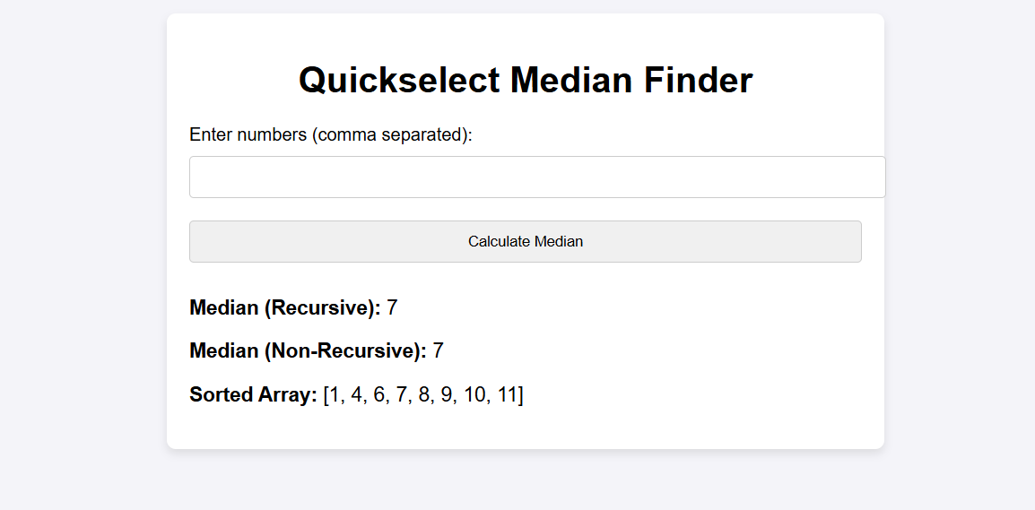
OUTOUT

Slide 10
Thank you!

